Slide 1


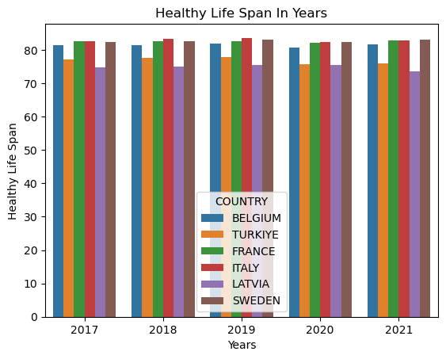
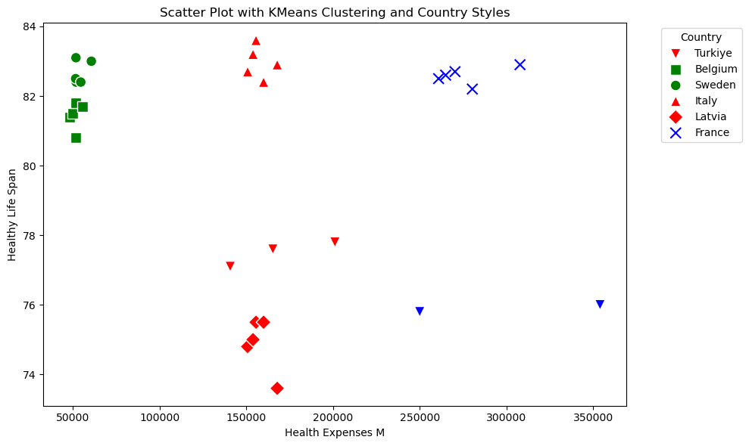
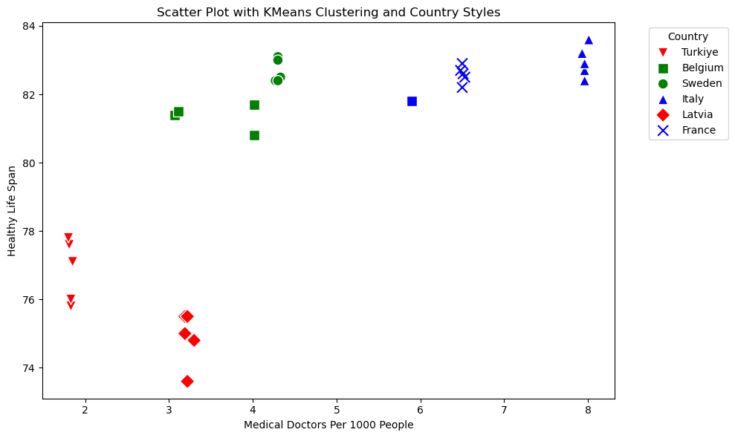
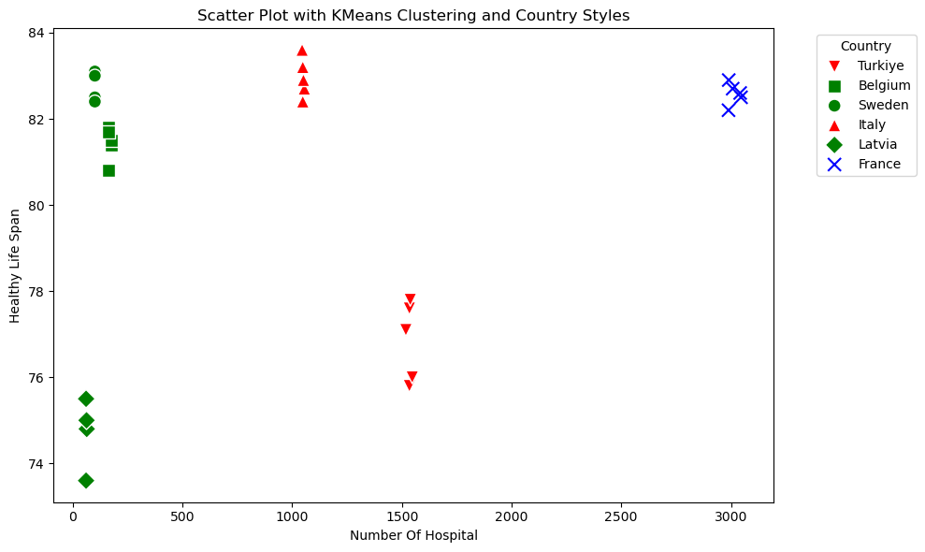
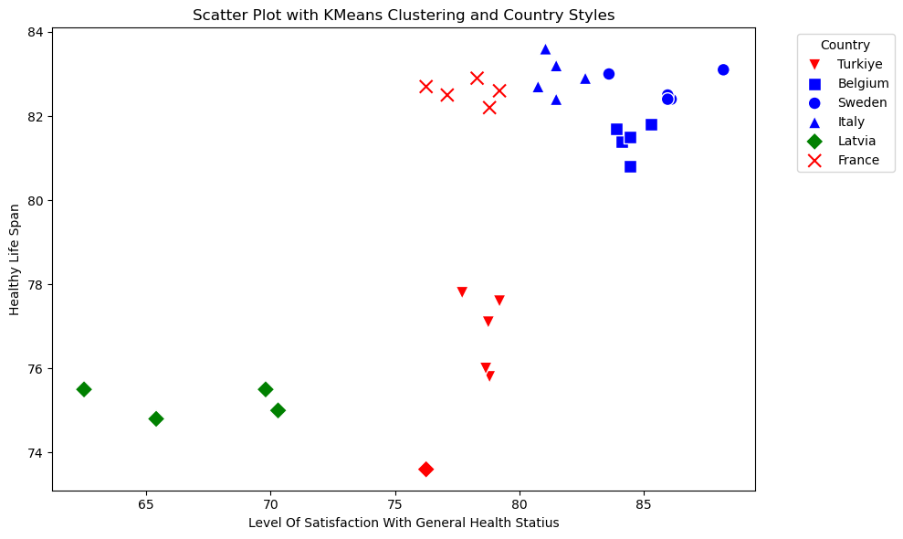
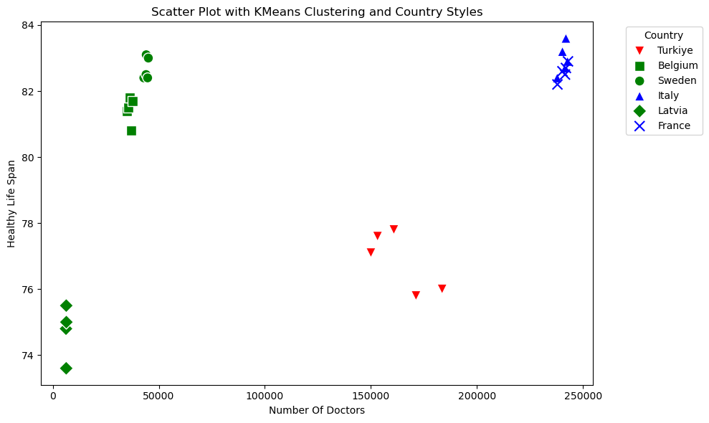
1. ISTANBUL NIŞANTAŞI UNIVERSITY
DATA MINING COURSE PROJECT EXHIBITION 2024
30 MAY 2024
Evaluating Healthcare Systems and Policies to Increase Life Expectancy
Name surname : Mustafa Nafi Uğur
PROJECT TEAM
Project Supervisor : Dr. Öğr. Üyesi Nesibe Manav Mutlu
ABSTRACT
This study evaluates the health systems of six countries to identify factors influencing life expectancy. Using regression and clustering analysis, we offer policy recommendations to improve healthcare and extend life expectancy.
INTRODUCTION
MATERIALS AND METHODS
Sustainable development, particularly in the context of health and well-being (SDG 3), is a global priority that affects health, welfare, and economic growth. This study analyzes life expectancy as a key indicator of health system effectiveness across six countries: Turkey, Sweden, Italy, Belgium, France, and Latvia. Understanding the factors influencing life expectancy is crucial for improving public health policies.
Despite significant healthcare investments, disparities in life expectancy persist. This study aims to uncover the reasons for these differences and offer insights for policymakers. Our methodology combines regression and clustering analyses to evaluate variables such as life expectancy, healthcare resources, satisfaction rates, and government expenditure. This comprehensive approach integrates both quantitative and qualitative aspects of healthcare systems.
The findings have broad applications for national and international health policy development, providing evidence-based recommendations to enhance health system effectiveness, improve patient outcomes, and increase life expectancy. This research serves as a vital reference for advancing health system performance and societal welfare.
1.Linear Regression
Objective : To predict healthy life span based on other health indicators.
Process : We conducted exploratory data analysis to understand the relationships between variables.
We split the dataset into training and test sets.
Using multiple linear regression, we modeled the relationship between the independent variables (health expenses, number of hospitals, number of doctors, satisfaction level, etc.) and the dependent variable (healthy life span).
We evaluated model performance using metrics such as R-squared and Mean Squared Error (MSE).
Results : We developed predictive models that identified significant factors affecting healthy life span, such as health expenses, the number of medical professionals per capita, and the level of satisfaction with general health status.
2. K-Means Clustering:
Objective : To categorize regions into clusters based on similar health characteristics.
Process : We normalized the dataset to ensure that each feature contributes equally to the distance calculations.
Using the Elbow Method, we determined the optimal number of clusters.
We applied the K-Means algorithm to partition the data into clusters, helping to identify regions with similar health profiles and needs.
Outcome : Identification of distinct clusters that represent different health and well-being statuses, allowing for targeted policy and resource allocation.
CONCLUSION AND RECOMMENDATIONS
Our study has demonstrated that life expectancy is closely tied to the number of doctors per 1000 people and the satisfaction rate of healthcare services. Interestingly, despite significant government spending on healthcare, an increase in life expectancy was not observed, indicating that the efficiency of fund allocation is more critical than the total expenditure. Our regression analysis highlights the need for targeted improvements in healthcare delivery rather than just increasing the financial investment.
Recommendations:
Efficient Resource Allocation: Countries should prioritize the efficient allocation of healthcare funds rather than merely increasing expenditure. Focus should be on enhancing the quality and efficiency of services provided.
Improving Healthcare Satisfaction: Patient satisfaction is a critical component of healthcare outcomes. Efforts to improve healthcare services, patient-doctor interactions, and overall patient care should be intensified to boost satisfaction levels.
Balanced Increase in Medical Infrastructure: While increasing the number of hospitals is beneficial, it should be accompanied by an appropriate increase in the number of healthcare professionals to ensure optimal functioning and patient care.
Focus on Preventive Care: Preventive care initiatives and public health programs can significantly enhance life expectancy. Investment in preventive measures, health education, and early diagnosis should be prioritized.
Strengthening Healthcare Workforce: Improving working conditions and incentives for doctors can attract more professionals to the field, thereby increasing the number of doctors per 1000 people and potentially improving healthcare outcomes.
Customized Strategies: Each country should tailor its healthcare strategies based on specific national circumstances and healthcare system strengths and weaknesses. Data-driven policy-making can ensure targeted and effective improvements.
By adopting these recommendations, countries can enhance their healthcare systems, leading to improved life expectancy and overall public health outcomes.
Key findings from the clustering analysis reveal diverse trends among the six countries studied.
Belgium and Sweden achieve high life expectancy with low healthcare investment and fewer hospitals, indicating efficient healthcare systems and high satisfaction rates. Italy, with moderate investment and a high number of doctors and hospitals, also enjoys high life expectancy, suggesting a well-balanced system. Latvia, despite moderate investment, has low life expectancy and low satisfaction rates, indicating inefficiencies. Turkey has moderate to high investment but only moderate life expectancy, highlighting the need for better resource allocation. France, with high investment, many hospitals, and a high doctor-to-patient ratio, achieves high life expectancy but has room to improve patient satisfaction.
REFERENCES
1. Öztürk, D. D. Z., Top, D. D. M., & Pehlevan, O. (2015). SAĞLIK SEKTÖRÜNDE YATIRIM PROJELERİNİN DEĞERLENDİRİLMESİ. Uluslararası Sağlık Yönetimi Ve Stratejileri Araştırma Dergisi, 1(2), 18-38. 9. Bundred, P. E., & Levitt, C. (2000). Medical migration: who are the real losers?. The Lancet, 356(9225),
2. Nichols, L. M., & Taylor, L. A. (2018). Social determinants as public goods: a new approach to financing key investments in healthy communities. Health Affairs, 37(8), 1223-1230. 245-246.
3. Shan, C., & Zhu, H. (2014). Bifurcations and complex dynamics of an SIR model with the impact of the number of hospital beds. Journal of Differential Equations, 257(5), 1662-1688. 10. Arnetz, J. E., Hamblin, L., Essenmacher, L., Upfal, M. J., Ager, J., & Luborsky, M. (2015). Understanding
4. Larsson, S. C., Kaluza, J., & Wolk, A. (2017). Combined impact of healthy lifestyle factors on lifespan: two prospective cohorts. Journal of internal medicine, 282(3), 209-219. patient‐to‐worker violence in hospitals: A qualitative analysis of documented incident reports. Journal
5. Martín, J. J. M., Puerto Lopez del Amo Gonzalez, M., & Dolores Cano Garcia, M. (2011). Review of the literature on the determinants of healthcare expenditure. Applied Economics, 43(1), 19-46. of advanced nursing, 71(2), 338-348.
6. Yardım, MS, Çilingiroğlu, N. ve Yardım, N. (2010). Türkiye'de yıkıcı sağlık harcamaları ve yoksullaşma. Sağlık politikası , 94 (1), 26-33.
7.National Academies of Sciences, Medicine Division, Board on Health Care Services, & Committee on Integrating Social Needs Care into the Delivery of Health Care to Improve the Nation's Health. (2019). Integrating social care into the delivery of health care: Moving upstream to improve the nation's health.
8. Bensing, J. (1991). Doctor-patient communication and the quality of care. Social science & medicine, 32(11), 1301-1310.

